Slide 1
Support Vector Machine Active Learning for Image Retrieval
Author:
Simon Ton,
Stanford University
Edward Chang,
University of California
Santa Barbara
Group Members:
Akshay Shetty (1001666052)
Abhay Singh (1001669333)

Slide 2
Introduction
1)Support Vector Machine.
2)Kernels.
3)Version Space.
4)Active learning.
5)Image Classification
6)Experiment
7)Steps
8)Result and Comparison

Slide 3
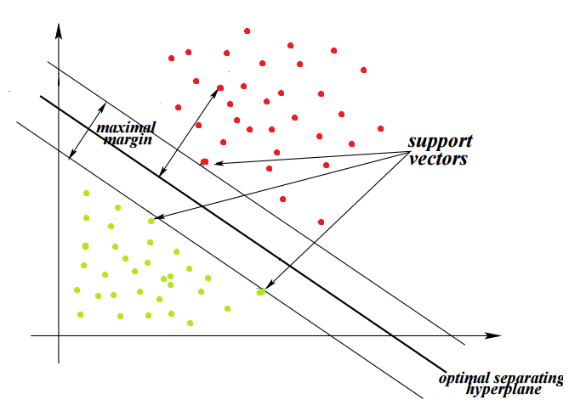
Support Vector Machine
Main idea is to identify the optimal separating hyperplane which maximizes the margin of the training data. The aim is to choose the hyperplane which is as far as possible from the data points of each category.

Slide 4
Support Vector Machine
1) SVM is a discriminative classifier defined by a separating hyperplane.
2) Given labeled training data (supervised learning), the algorithm outputs an optimal hyperplane which categorizes new examples.
3) In 2D space this hyperplane is a line dividing a plane in two parts where in each class lay in either side.
4) What if the datasets are plotted in such a way that they are not linearly separable?

Slide 5
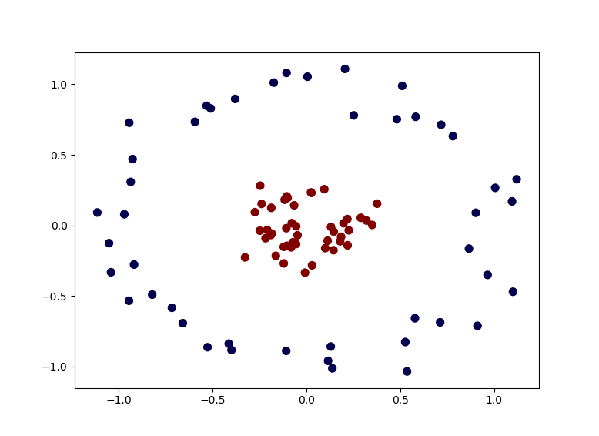
Non Linear Dataset

Slide 6
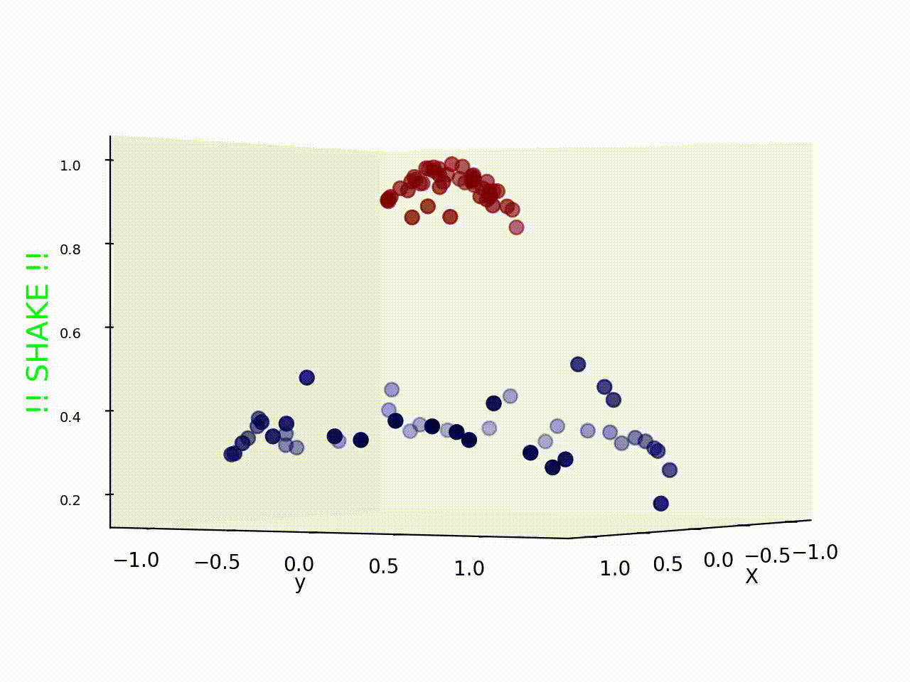
Kernel Trick

Slide 7
Kernel trick in SVM
1)Mapping data points from a dimensional space to higher dimensional space is a time consuming task
2)To avoid this Kernel is used as a mapping function to map a data point into higher dimensional space for classification.
3) Mathematical definition: K(x, y) = <f(x), f(y)>. Here K is the kernel function, x, y are n dimensional inputs. f is a map from n-dimension to m-dimension space. < x,y> denotes the dot product. usually m is much larger than n.
4) <f(x), f(y)>, in the context of SVM and feature vectors, it becomes <phi(x), phi(y)>. The inner product means the projection of phi(x) onto phi(y). or how much overlap do x and y have in their feature space. In other words, how similar they are.

Slide 8
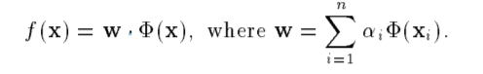
Kernel Trick
1)The output is predicted by below given formula:
Where, if f(x) >=0, then predicted out is 1 or else its -1.

Slide 9
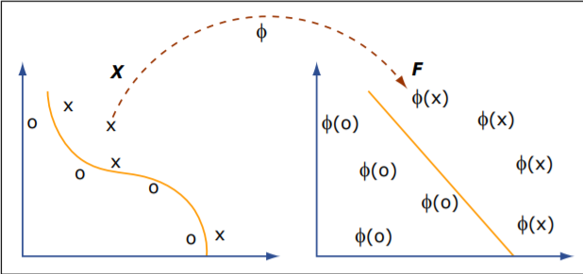
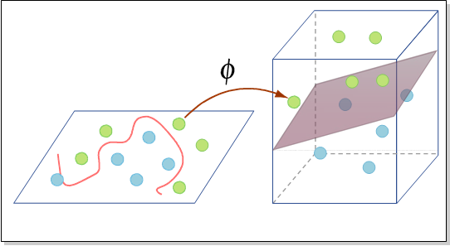
Kernel Trick

Slide 10
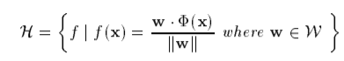
Version Space
The set of consistent hyperplanes that separate the data in the induced feature space F is known as a Version Space.
In other words, hypothesis f is in version space if for every training instance xi with label yi we have that f (xi) > 0 if yi = 1 and f(xi) < 0 if yi = 1.
The hypothesis is given by:
Where, f: hypothesis
W: parameter space

Slide 11
Version Space
4) Since H is a set of hyperplanes, there is an exact correspondence between unit vectors w and hypotheses f in H.
5)The Version Space V is defined as:

Slide 12
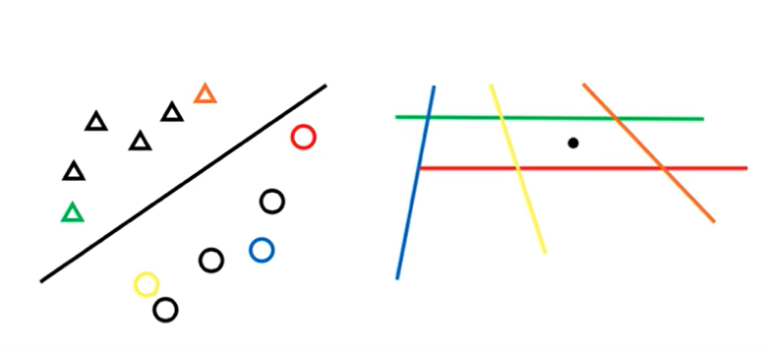
Duality

Slide 13
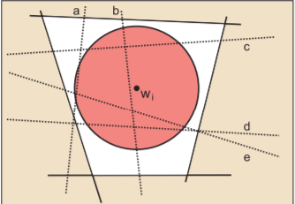
Version Spaces
SVM find the center of the largest radius hypersphere whose center can be placed in version space and whose surface does not intersect with the hyperplanes corresponding to the labeled instance.

Slide 14
Active learning
1) Principle- Learn an SVM on the existing labeled data and choose as the next instance to query the pool instance that comes closest to the hyperplane in F
2) Pool-based active learning
3) Query concept - User interaction with the learning process
4) Relevance feedback- relevant or not

Slide 15
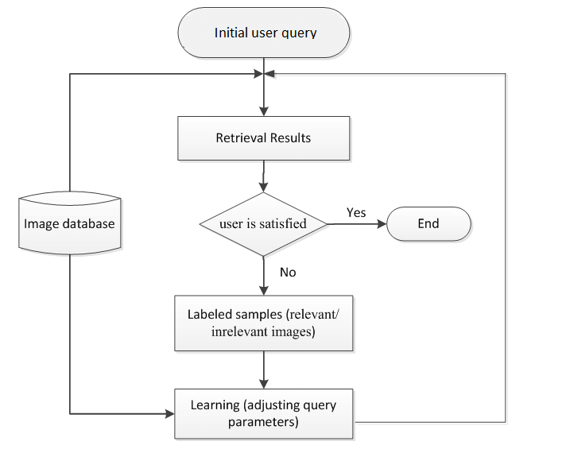
The CBIR system with Relevance Feedback

Slide 16
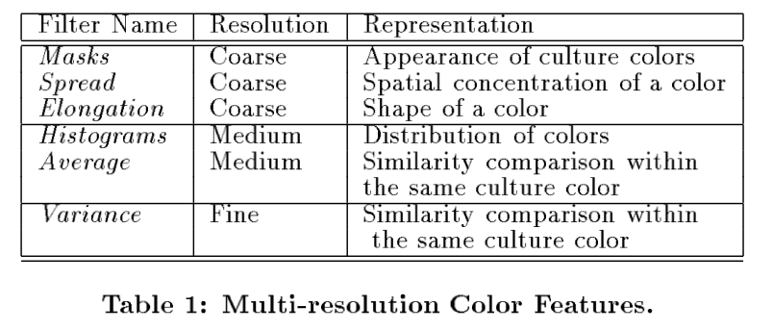
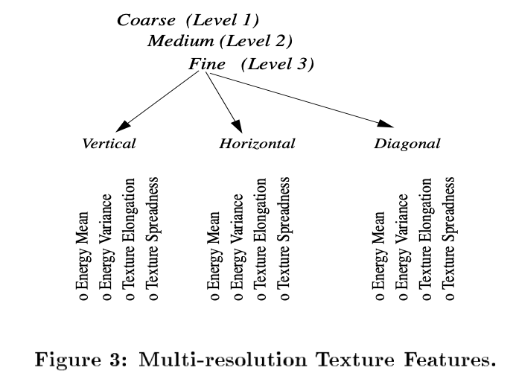
Image Feature vector
Color feature: 12 color bins * 9 features(including HSV) = 108 features
Texture feature: 3 levels * 3 orientations * 4 features = 36 features
Total number of dimensional vector = 108 + 36 = 144 features

Slide 17
Experiment
3 real world image dataset: Increase learning difficulty
(602) 4-category: architecture, owers, landscape, and people
(1277) 10-category set: + , bears, clouds, objectionable images, tigers, tools, and waves.
(1920) 15-category set: +, elephants, fabrics, reworks, food, and texture

Slide 18
Steps:
Relevance feedback:
We start with one randomly selected relevant image and one randomly selected irrelevant image.
if 1st round
Learn SVM
SVM_{Active} randomly chooses 20 images.
else:
Learn SVM
Simple active querying method
Retrieval phase:
Learn Final SVM
SVM_{Active} retrieves the top-k most relevant images farthest from SVM boundary.

Slide 19
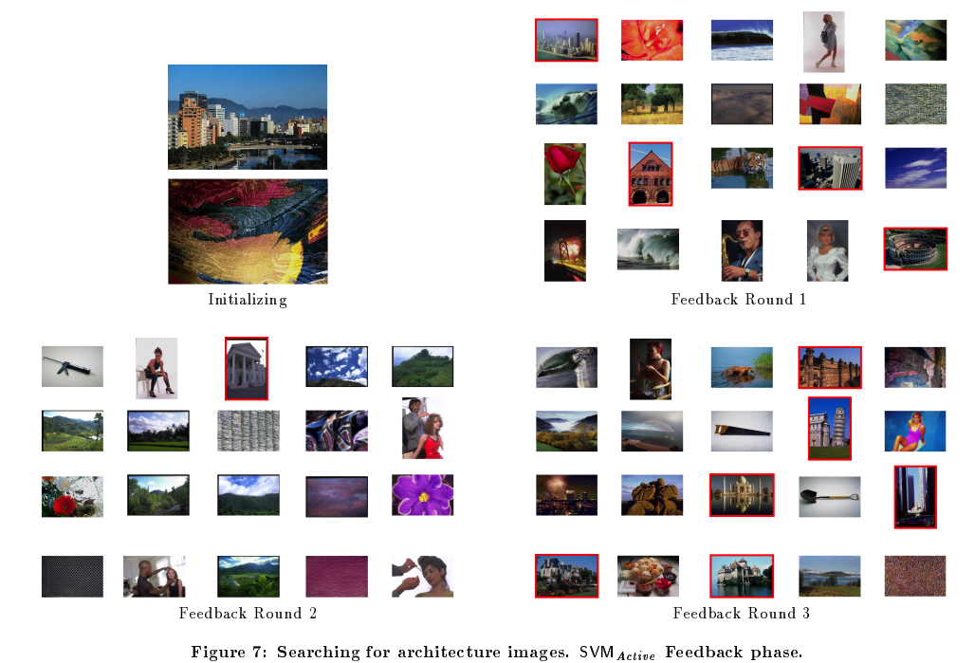

Slide 20
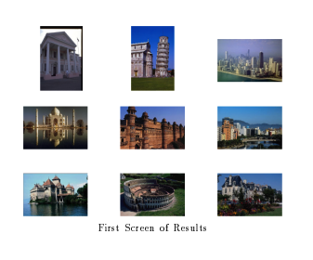
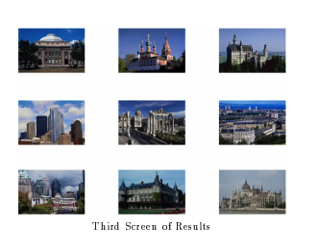
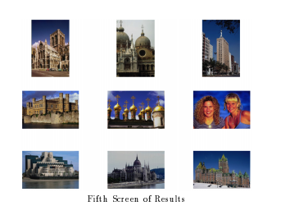
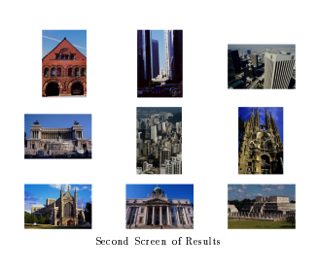
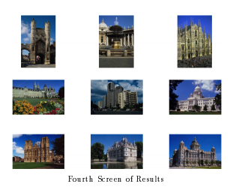
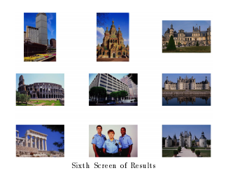

Slide 21
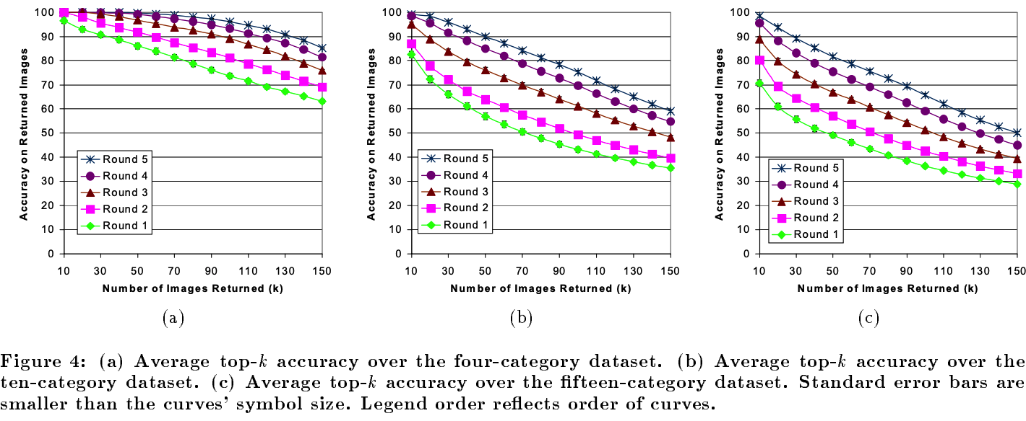
Result and Conclusion:
Accuracy decreases with increase of image categories

Slide 22
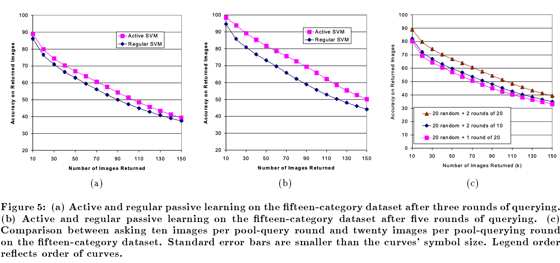
Figure a,b represent accuracy increases with round of querying.
Figure c represent accuracy increases with number of images.

Slide 23
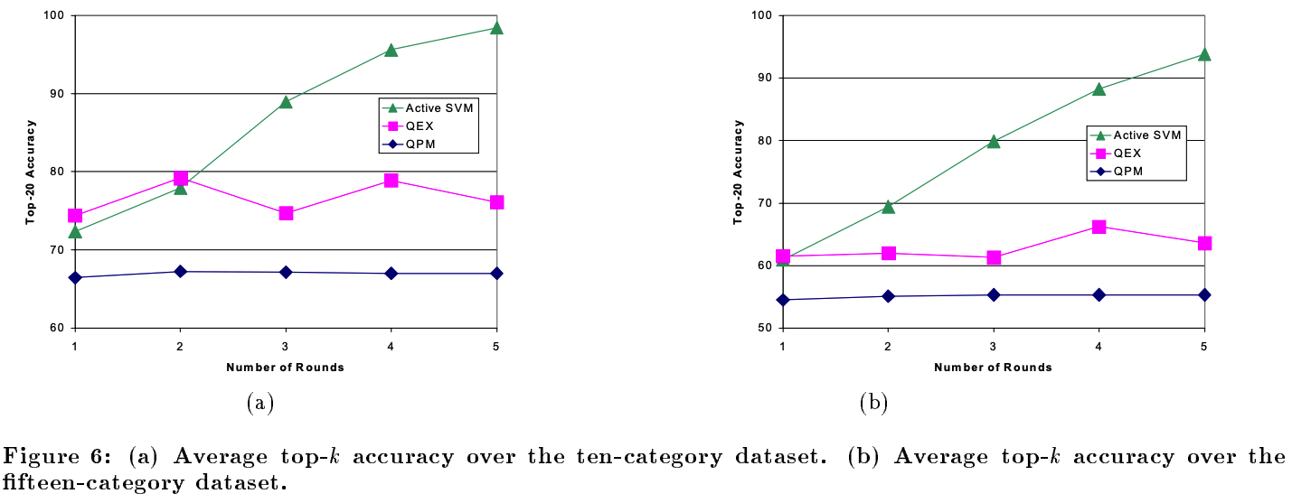
Comparision between SVM_{Active}, QEX, QEM

Slide 24
Thank you

